Slide 1

Business Analyst Careers
Documentation

Slide 2
Table of Content
Slide 3 Overview
Slide 4 Four Columns Display
Slide 5 Top 20 Industries
Slide 6 Top 20 Sectors
Slide 7 Top 20 Headquarters
Slide 8 Top 15 Jobs on Rating
Slide 9 Top 15 jobs based on Rating under “Consulting” industry
Slide10 Bottom 15 jobs based on Rating
Slide 11 Top 10 Companies with rating greater than 3 and under industry “Consulting”
Slide12 Top 10 Companies with rating greater than 3 and under “Energy” Industry
Slide 13 Top 10 Companies with rating greater than 3 and under “Accounting” Industry
Slide 14 Top 5 sectors by Popularity (number of occurrence)
Slide 15 Bottom 5 sectors by popularity (no of occurrence)
Slide 16 plot of top 20 sectors by salary
Slide 17 plot of bottom 5 sectors by salary
Slide 18 plot of top 10 sectors by rating
Slide 19 Plot of 10 top & least rated companies
Slide 20 Top& Bottom 5 Ratings by Ownership
Slide 21 Top & Bottom 5 Salaries by Type of ownership
Slide 22-24 Observations and Conclusion

Slide 3

Overview
This document provides a comprehensive overview of a wide range of jobs, detailing the various companies, industries, and sectors in which they are found, as well as the corresponding salary rating information for each.

Slide 4
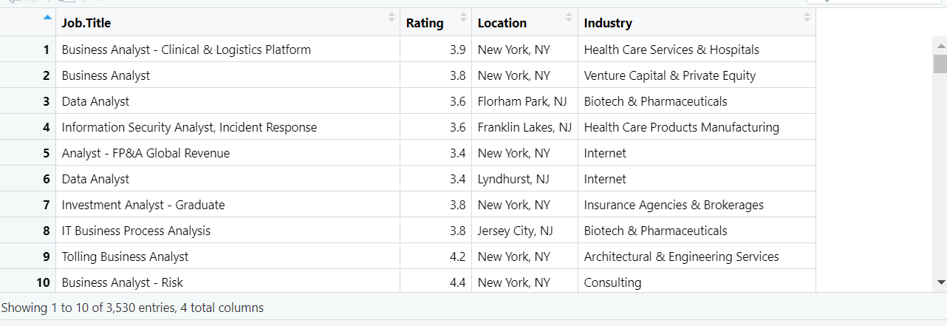
Table displaying four columns (Job Title , Rating , Location, Industry)

Slide 5
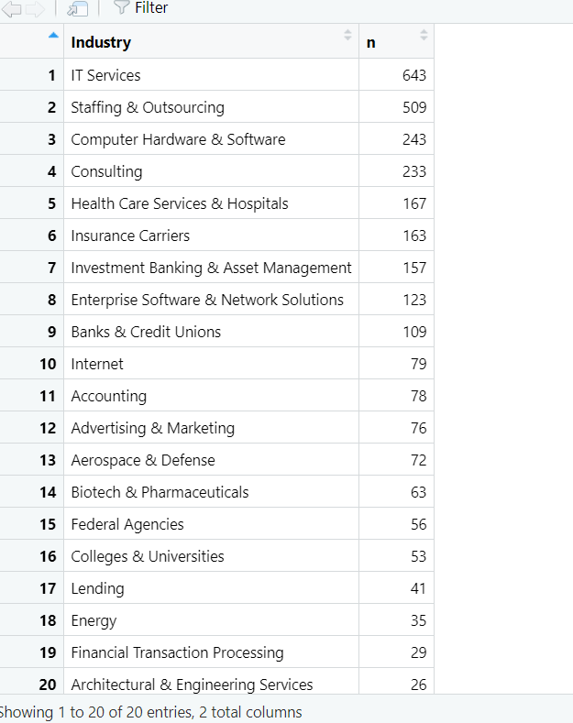
Top 20 Industries

Slide 6
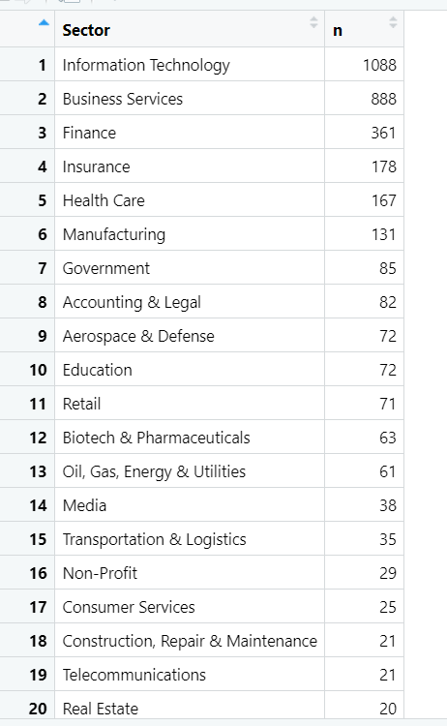
Top 20 Sectors

Slide 7
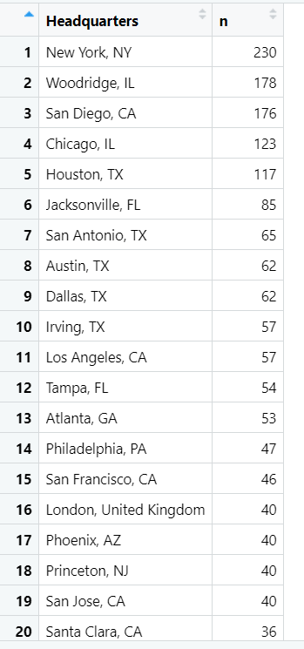
Top 20 Headquarters

Slide 8
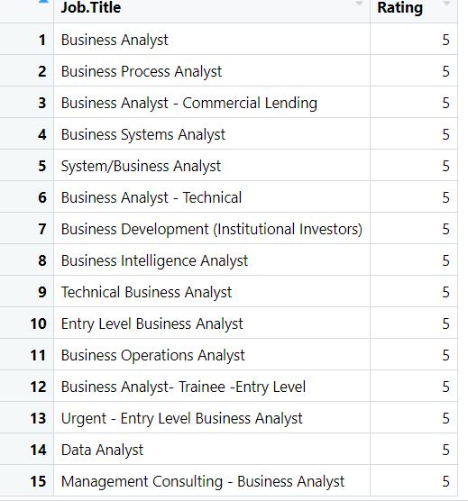
Top 15 jobs based on Rating

Slide 9
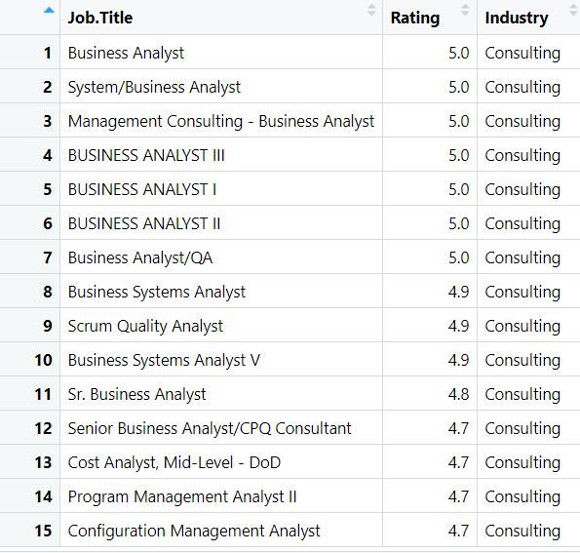
Top 15 jobs based on Rating under “Consulting” industry

Slide 10
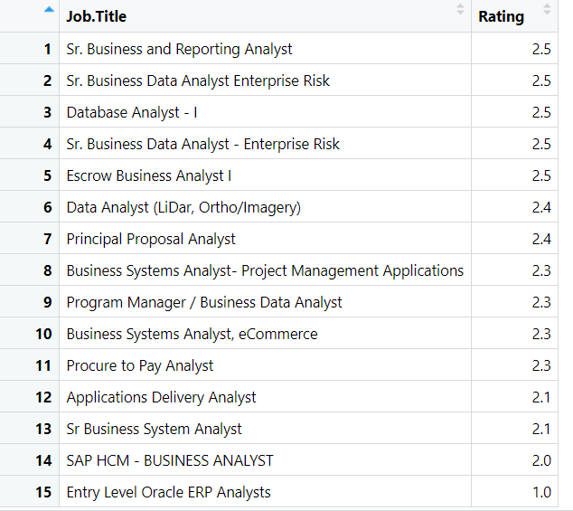
Bottom 15 jobs based on Rating

Slide 11
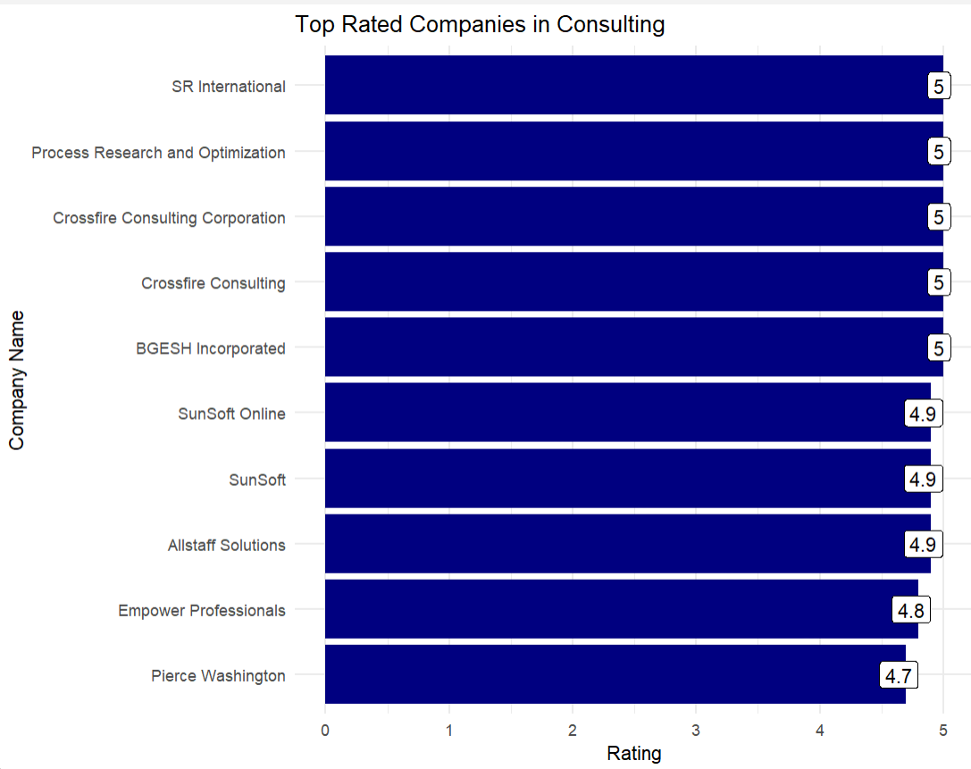
Top 10 Companies with rating greater than 3 and under industry “Consulting”

Slide 12
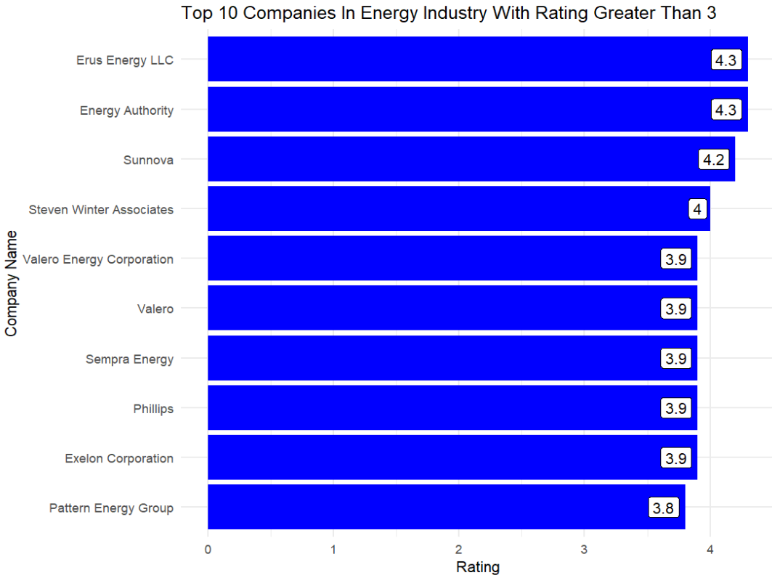
Top 10 Companies with rating greater than 3 and under “Energy” Industry

Slide 13
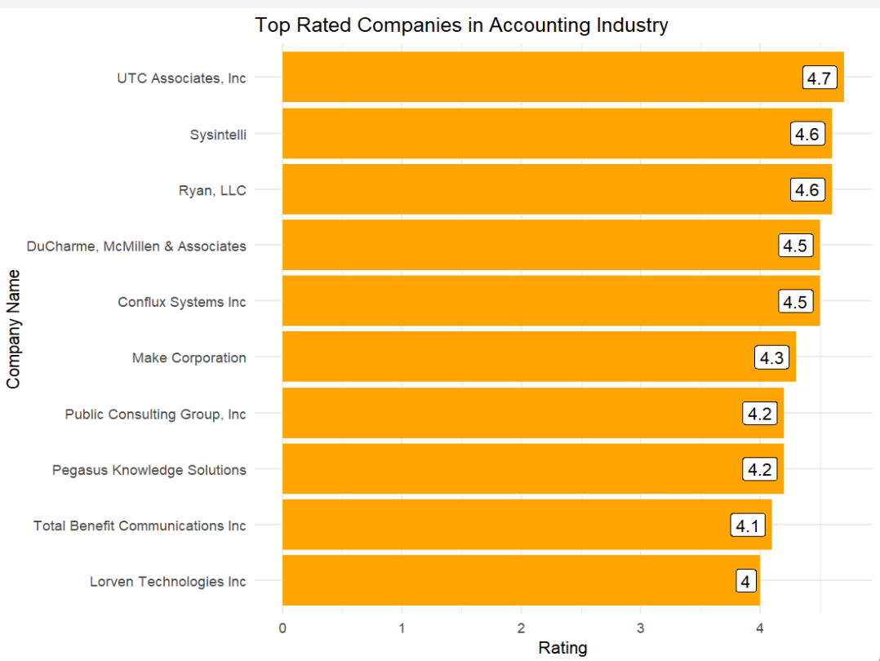
Top 10 Companies with rating greater than 3 and under “Accounting” Industry

Slide 14
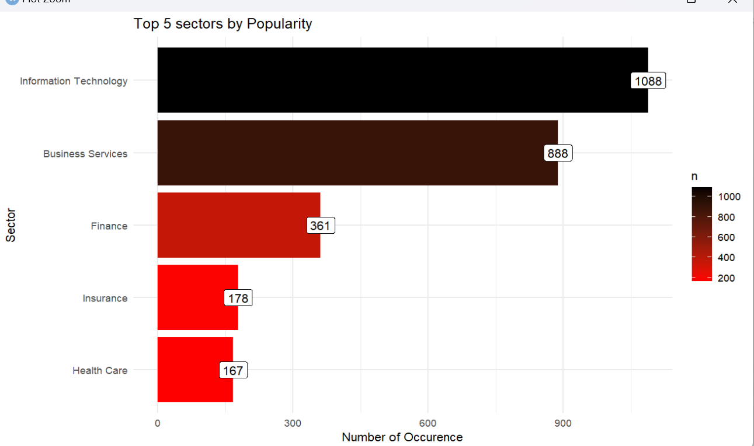
Top 5 sectors by Popularity (number of occurrence)

Slide 15
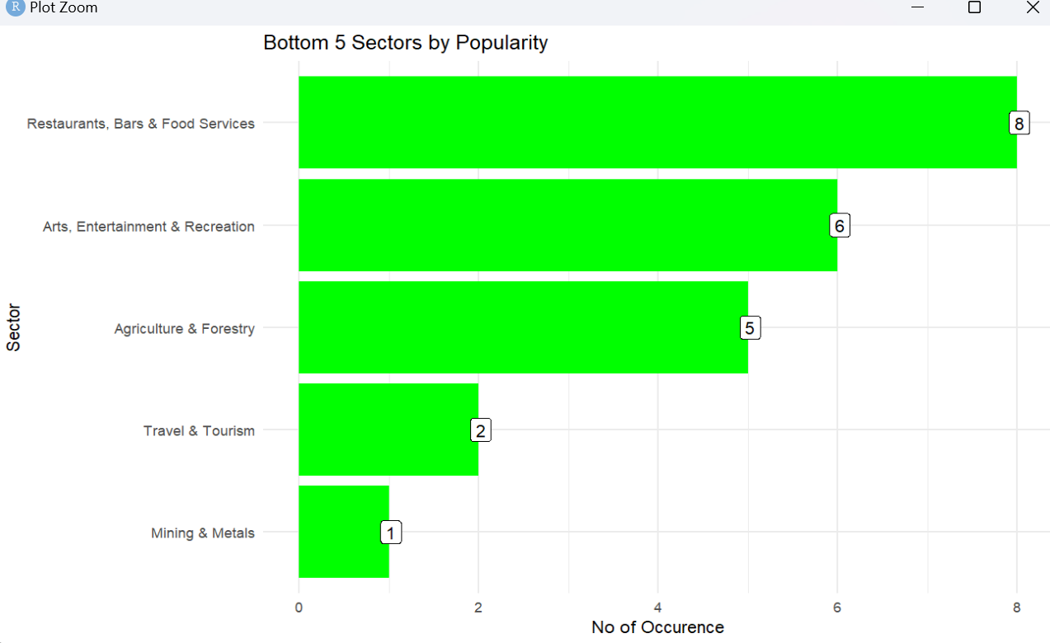
Bottom 5 sectors by popularity (no of occurrence)

Slide 16
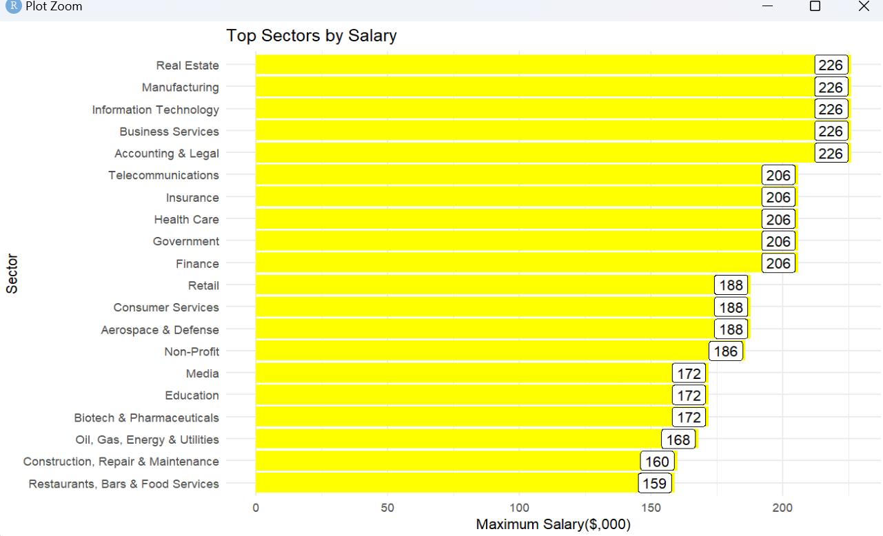
Plot of Top 20 Sectors by Salary

Slide 17
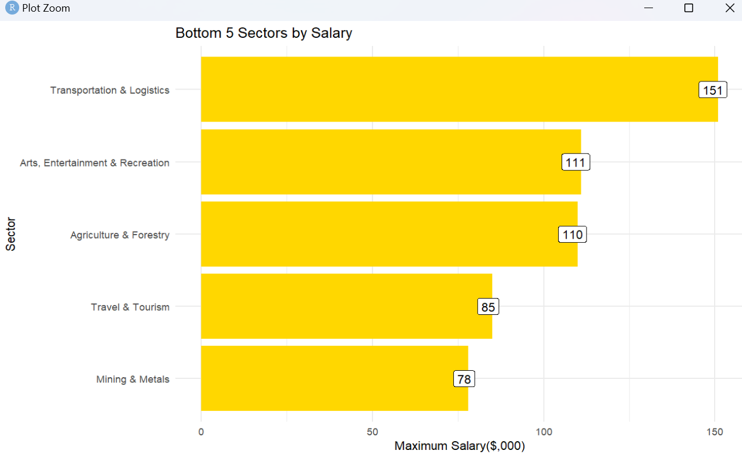
Plot of Bottom 5 Sectors by Salary

Slide 18
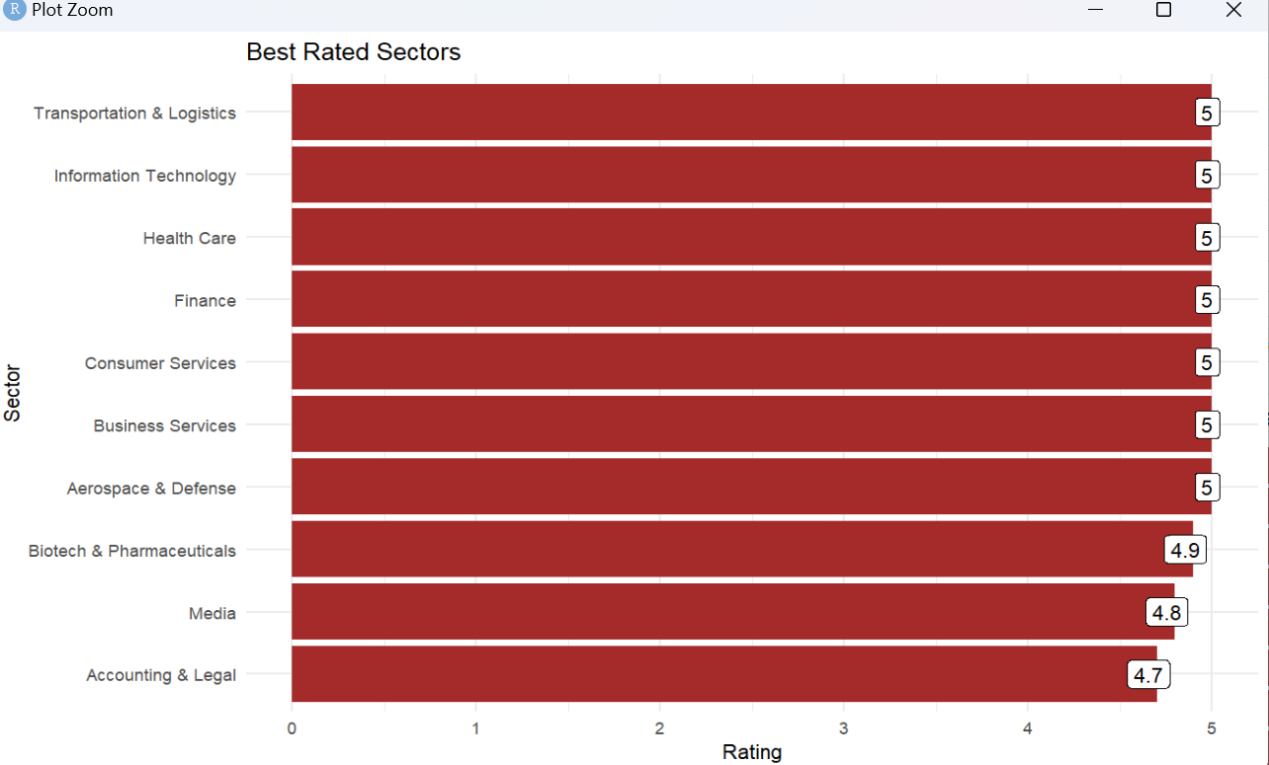
Plot of top 10 sectors by rating

Slide 19
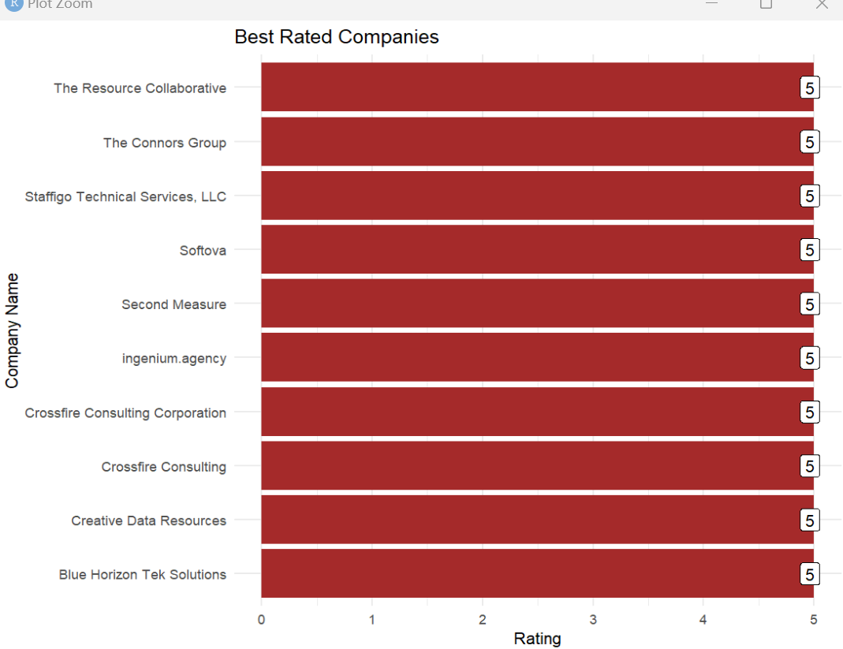
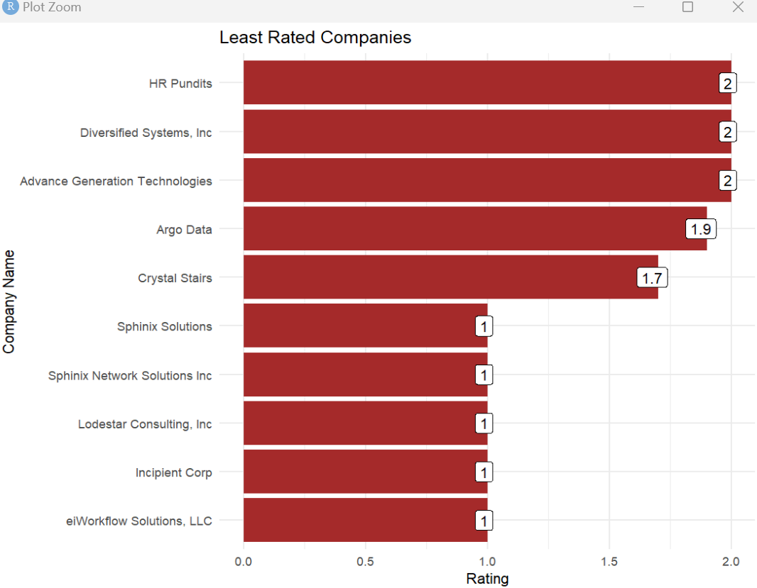
Plot of 10 top & least rated companies
Plot of top 10 rated companies
Plot of 10 least rated companies

Slide 20
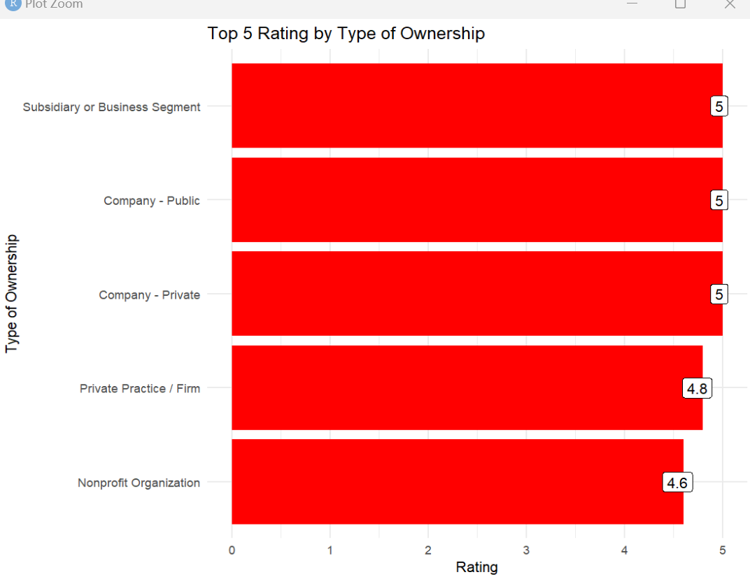
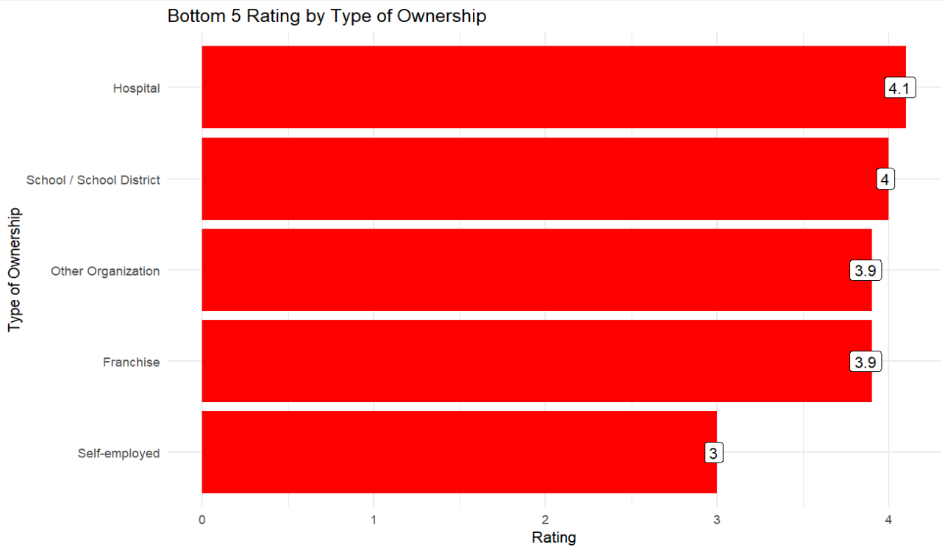
Top& Bottom 5 Ratings by Ownership
Top 5 Ratings by Ownership
Bottom 5 Ratings By Ownership

Slide 21
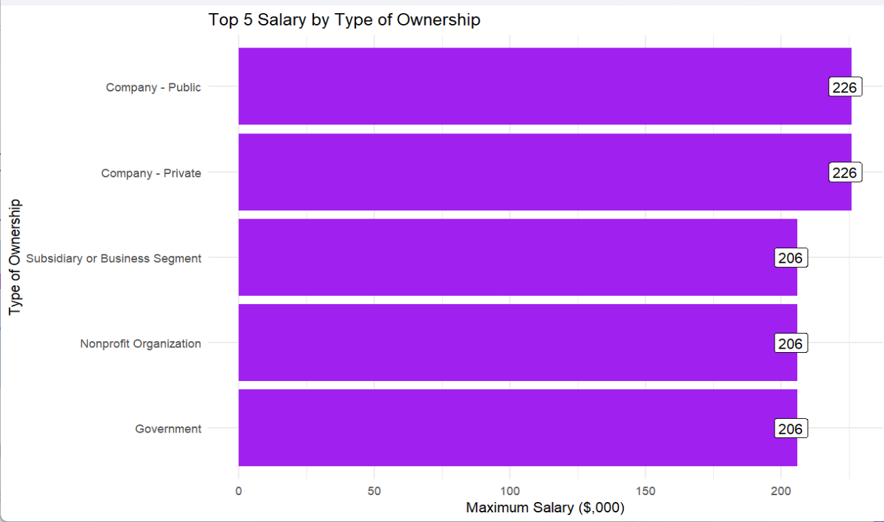
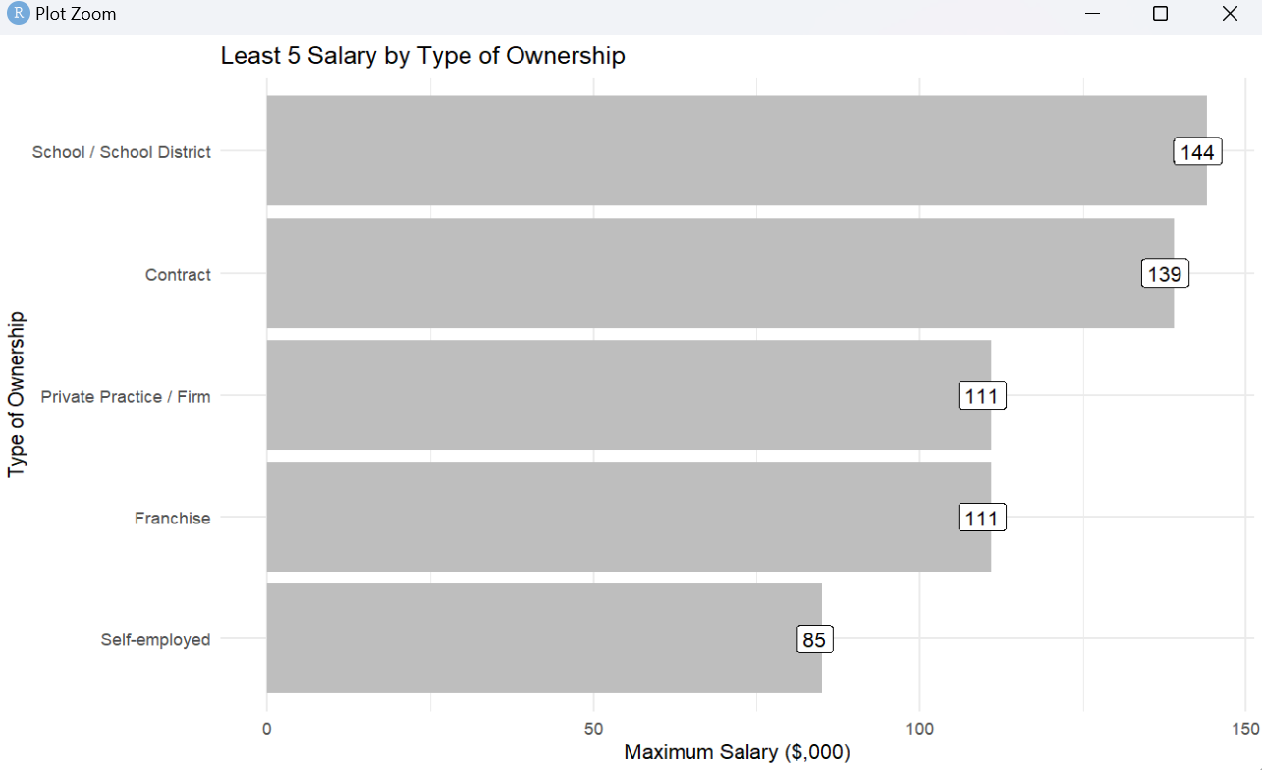
Top & Bottom 5 Salaries by Type of ownership
Top 5 Salaries by type of ownership
Bottom 5 Salaries by type of ownership

Slide 22
Observation & Conclusion
UTC Associates, Inc. has the best rating under the Accounting Industry with a rating of 4.7. Erus Energy LLC and Energy Authority have the best ratings in the Energy industry with ratings of 4.3 each. Crossfire Consulting Corporation, Crossfire Consulting, Process Research and Optimization, SR International and BGESH Incorporated are perfectly rating at 5.0 in the Consulting industry which means they are very outstanding when it comes to anything consultancy.
Information Technology, Business Services, Real Estate, Accounting & Legal, and Manufacturing top the list with the highest salaries. Insurance, Telecommunications, Finance, Government, and Health Care also offer lucrative salaries, likely due to the need for specialized skills and knowledge.
The range of sectors from Transportation to Arts reflects diverse job types and industries where earnings vary based on the specific nature of the work. Lower salaries in Agriculture, Travel & Tourism, and Mining might be due to industry-specific challenges such as seasonality, market demand, and labour intensity. The Mining & Metals sector has the lowest salary among the listed sectors, which is surprising given the often hazardous and specialized work involved.
Information Technology (IT) sector is the most popular, reflecting the high demand for technology-related jobs and the rapid growth of the tech industry. Continuous technological advancements and the integration of IT into various industries is a major reason for this popularity. IT and Business Services lead in popularity, reflecting current market trends and economic focus on technology and business efficiency. Finance, Insurance, and Health Care sectors are popular due to their essential roles in personal and corporate well-being, offering stability and growth opportunities.

Slide 23
Observation & Conclusion Continued….
Many of these sectors in the bottom 5 popularity offer lower wages and less job stability compared to other industries, making them less attractive to workers. Physical demands, irregular hours, and challenging work conditions contribute to the lower popularity of these sectors. Sectors like Travel & Tourism and Arts & Entertainment are highly sensitive to economic and global events, affecting job security and attractiveness. Sectors such as Mining & Metals face additional challenges due to safety risks and environmental impact; and Jobs are often in remote, less accessible areas further reducing their appeal.
Many of the top-rated sectors are in high demand and offer strong job stability. These sectors generally provide attractive compensation packages. Opportunities for professional development and career advancement are prevalent. Sectors like IT, Aerospace & Defense, and Biotech offer innovative work that can have significant societal impacts. Industries such as Media and Consumer Services provide diverse roles and a dynamic working environment, contributing to their high ratings.
Low ratings in some sectors are often due to job instability, low wages, physically demanding work, and challenging working conditions. Each sector has unique challenges that contribute to lower ratings, such as the rapid technological evolution in telecommunications or the hazardous conditions in mining. Sectors like travel and tourism are highly sensitive to economic changes, leading to job insecurity.
Private and subsidiary companies tend to rate highly due to their flexibility, innovation capabilities, and supportive environments. Public companies offer stability, extensive benefits, and career growth opportunities, contributing to high ratings. Private practices offer autonomy and close client relationships, enhancing job satisfaction.

Slide 24

Observation & Conclusion Continued….
Across these types of ownership, factors such as resource constraints, administrative bureaucracy, inconsistent management practices, financial instability, and work-life balance challenges play a major role in lowering employee satisfaction.
Hospitals and schools face high stress, resource limitations, and administrative challenges that can lower employee satisfaction. Franchises and other organizations deal with operational constraints and varied management practices, leading to inconsistent job experiences. Self-employed individuals face significant financial uncertainty and work-life balance challenges, contributing to the lowest satisfaction ratings.
Employees of public and private companies are compensated the most, followed closely by those working in subsidiaries or specific business segments of larger entities, government positions, and nonprofit organizations, all offering relatively similar salary levels.
Self-employed individuals generally earn the least salaries, whereas employees in school districts or contracted positions tend to earn slightly higher salaries. Those working in franchises and private practices or firms earn salaries at a similar, intermediate level.

